Slide 1
Slides for Basic Image Analysis in Python
David Mellert, PhD

Slide 2
Arrays are multidimensional data structures
1D array:
1
5
3
1
7
2
2D array:
8
5
2

Slide 3
Arrays are multidimensional data structures
4
6
1
3
6
1
3D array:
8
9
3
1
7
2
8
5
2
8
5
2

Slide 4
Arrays are multidimensional data structures
4
6
1
2
5
8
3
6
1
9
3
1
4D array:
8
9
3
8
9
3
1
7
2
1
7
2
8
5
2
8
5
2
8
5
2
9
6
0

Slide 5
Arrays are multidimensional data structures
4
6
1
2
5
8
3
6
1
9
3
1
4D array:
8
9
3
8
9
3
1
7
2
1
7
2
8
5
2
8
5
2
8
5
2
9
6
0
These red cells are adjacent

Slide 6
Arrays are multidimensional data structures
4
6
1
2
5
8
3
6
1
9
3
1
4D array:
8
9
3
8
9
3
1
7
2
1
7
2
8
5
2
8
5
2
8
5
2
9
6
0
These are also adjacent

Slide 7
Arrays are multidimensional data structures
4
6
1
2
5
8
3
6
1
9
3
1
4D array:
8
9
3
8
9
3
1
7
2
1
7
2
8
5
2
8
5
2
8
5
2
9
6
0
These are also adjacent

Slide 8
Grayscale images are 2D arrays
3x3 pixels
zoomed-in
150x200 pixels
image

Slide 9
Grayscale images are 2D arrays
213
89
77
255
177
136
232
211
89
3x3 pixels
zoomed-in
150x200 pixels
image

Slide 10
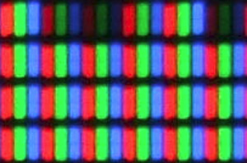
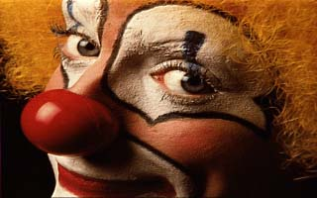
2D color images are 3D arrays

Slide 11
2D color images are 3D arrays
255,255,255
85,92,68
40,70,42
255,255,255
255,255,255
255,255,255
255,255,255
255,255,255
255,255,255

Slide 12
2D color images are 3D arrays
Y
255
68
42
255
92
70
255
85
40
255
255
255
255
255
255
255
X
255
255
255
C (color)

Slide 13
Section on filtering and convolutions

Slide 14
Section on binary operations

Slide 15
Section on labeling connected regions

